Slide 1
Modern Introduction to Packet Radio
BBS, APRS, TCP/IP, and NPR in 2024
Billy Penley, KN4MKB
03/19/2024

Slide 2
Introduction
Why a “Modern Introduction”?
As time moves on, It’s important to reevaluate the “state” of specific technology. Although many of us know all about packet radio, it’s important that new people can get introduced to it in a way that isn’t scattered pieces of information in a 3 decade time span. This set of presentations will be designed to give an introduction to packet radio in a way that gives those new to it a way to decide what they want to do with it by providing a foundation and structured learning path.

Slide 3
“Course” Outline
Modern Introduction to Packet Radio (This Video/Slide)
TNC’s and Mastering Direwolf
APRS with Pinpoint APRS and Xastir
BBS(Bulletin Board systems) Creation and Connection with JNOS/BPQ32 software.
TCP/IP Networking with Packet Radio at 1200baud.
TCP/IP Networking with Packet Radio via VARA over HF.
Introduction to New Packet Radio

Slide 4
What is “Packet Radio”?
While the term “radio” describes the medium in which the data is sent, “packet” in this context was coined around the 1960’s. Although it’s a given these days that we use data packets for almost all modern network communication, during that time “packet switching” was a network engineering principal being developed alongside other switching protocols like circuit switching and message switching. It is basically the act of dividing up the data into packets that can be sent in turn

Slide 5
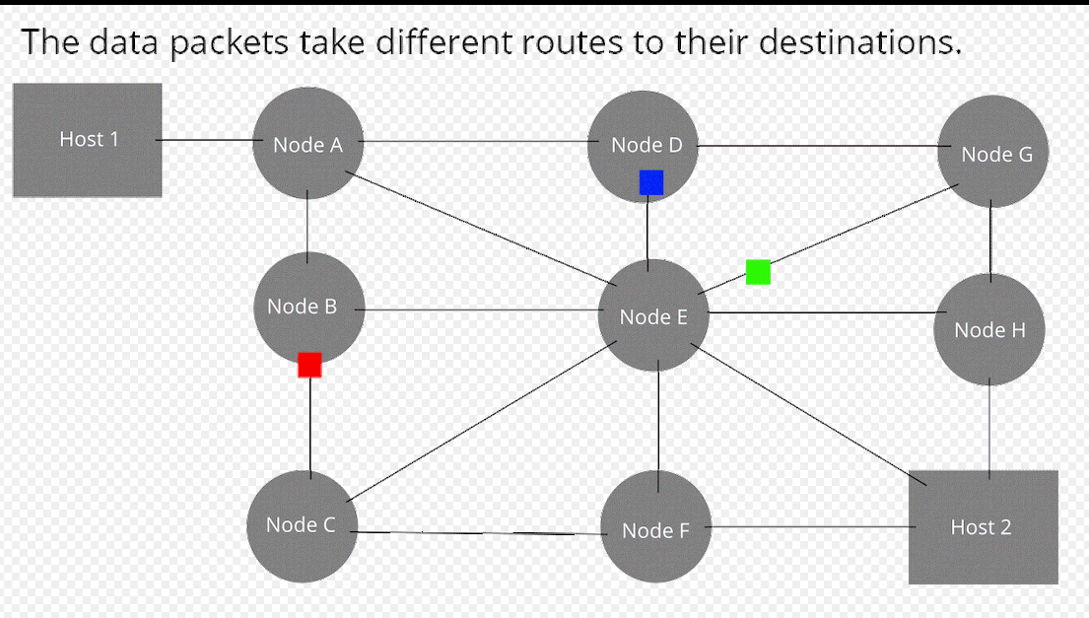

Slide 6
Brief History
Pre-Amateur Radio Use
Packet radio was invented in the 1960’s, when early network engineers were trying to solve the problem of having several network devices attempting to communicate with a simplex connection. In 1970, the first well known packet radio network was made by a professor at The University of Hawaii called the ALOHAnet. Later in 1973, the DAPPA(Defense Advanced Research Projects Agency) created a network called PRNET with the goal of integrating Packet Radio with ARPANET, which is the precursor to the public internet. This experiment was successful making it one of the first instances of internetworking.

Slide 7
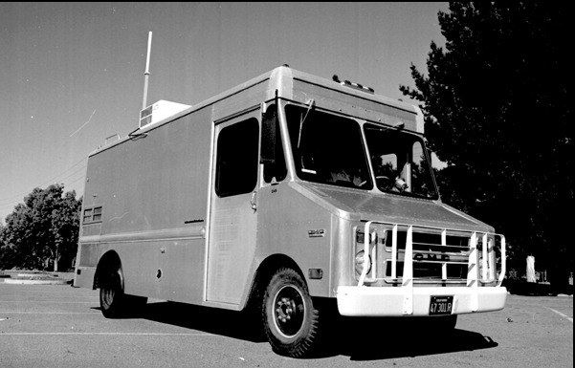
A Stanford Research Institute's Packet Radio Van
Site of the first three-way internetworked transmission

Slide 8
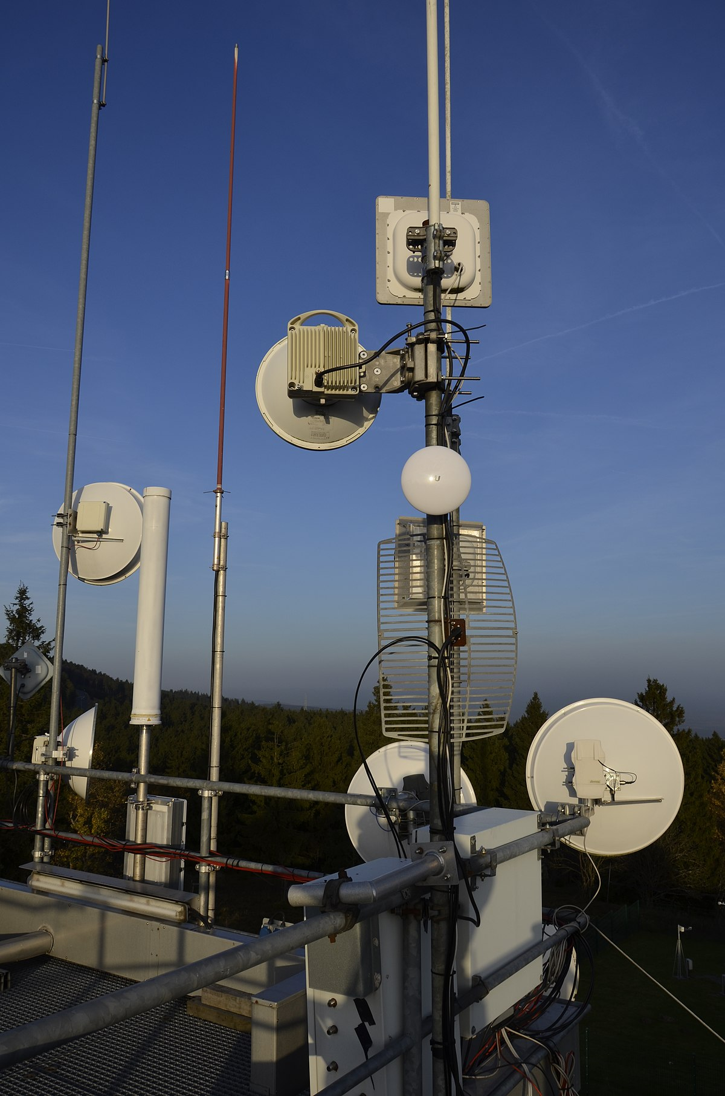
Brief History
First Amateur Use
In 1978, a group of amateurs out of Montreal Canada started using packet radio to transmit ASCII encoded data within the VHF band. Shortly after, in 1980 the FCC granted permission for amateurs in the united states to start using packet radio. In 1981, a IP range of 44.0.0.0/8 was designated for amateur radio digital communication, giving birth to Network 44( AMPRNet). Shortly after, the public Internet gained traction, and interest in packet radio started to decline.
Antennas for High-speed Amateur-radio Multimedia Network (HamNET) in Europe, part of the AMPRNet wireless mesh network

Slide 9
Brief History
Post Amateur Use
With the popularity of the world wide web, interest in packet radio started to fade. Then in 1984, the APRS(Automatic Packet Reporting system), which is a popular use of packet radio was created by Bob Bruninga, WB4APR was created. This mode, which was originally used to track horses during races saw lots of traction due to it’s wide functionality. It’s ability to report GPS positions, send messages, and integration into modern radios makes it the most prominent use of packet radio today. Although packet radio BBS(Bulletin Board Systems) and other Packet Radio based systems are still used by some hams today, APRS is by far the most popular..

Slide 10
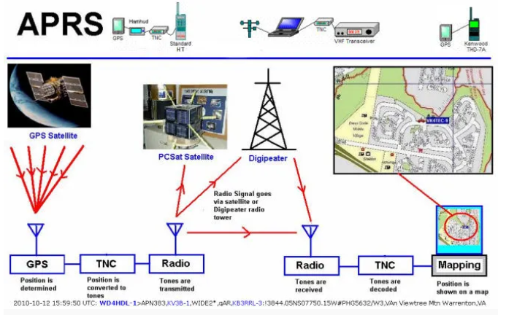
Image from W3PGA.

Slide 11
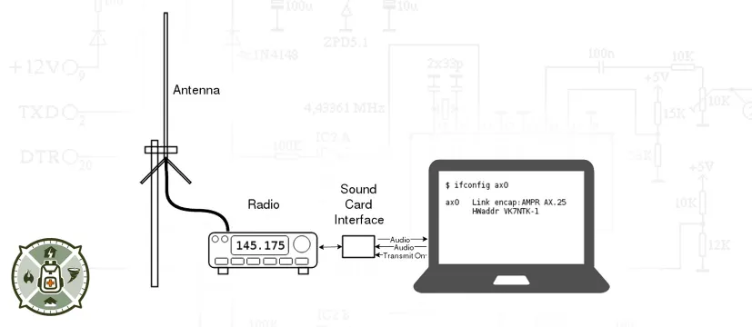
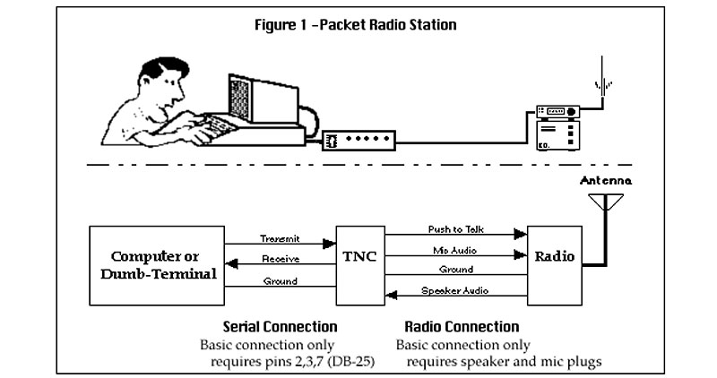
What’s needed for Packet Radio?
A radio capable of interfacing with a computer or hardware TNC(If a TNC is not included within the radio) via sound card interface and preferably, but highly recommended a PTT(Push to Talk) Interface.
A TNC (Terminal Node Controller) – Can be Hardware or Software.
(We will talk more about this next)
A computer capable of running software that can generate AX.25 Packets(Basically any modern computer, as well as several micro computers like the Raspberry Pi)
https://www.bugoutbagbuilder.com
https://www.bugoutbagbuilder.com

Slide 12
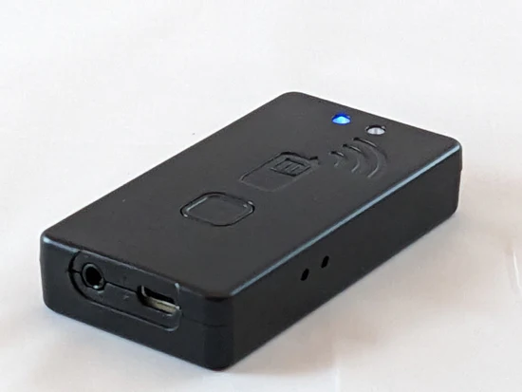
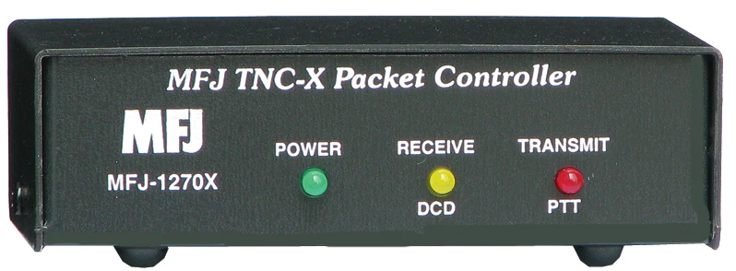
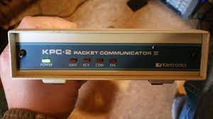
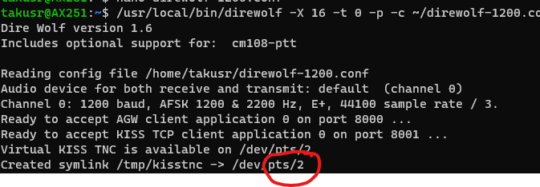
What’s a TNC(Terminal Node Controller?)
Mobilinkd Bluetooth Wireless TNC
MFJ TNC For Packet Radio
Kantronics KPC-2 TNC
Direwolf(Software TNC)

Slide 13
Can be Hardware or Software Based
(Typically) includes a modem to generate audio tones from digital signals and the other way around.
Provides some CLI(Command Line Interface) for the user or applications to send and receive data with the AX 25 protocol.
Data is usually sent in a format called “KISS”(Keep it simple Stupid)
Older hardware TNC’s often came with onboard BBS software, eliminating the need for a computer.
Some Radios have a built in TNC. Some of the builtin TNC’s can be interfaced with a computer for complete control and use. Others are “locked” to specific functions.
If generating packet data with a computer, the TNC provides an interface to the radio itself for the computer.
(Usually via Soundcard and PTT Signal)
Think of the TNC as the tool that gets
data in and out of your radio.

Slide 14
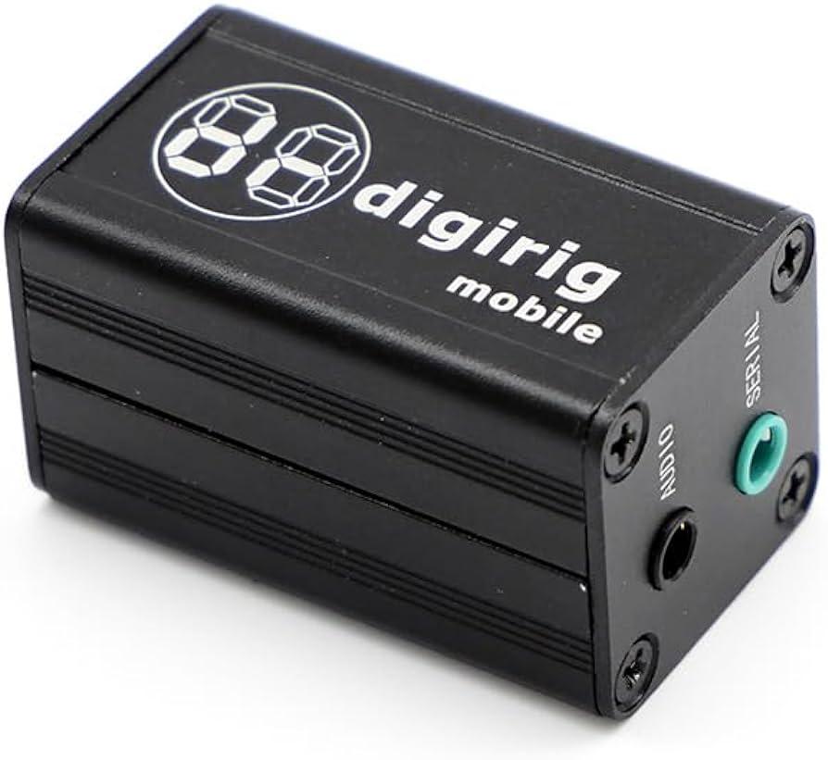
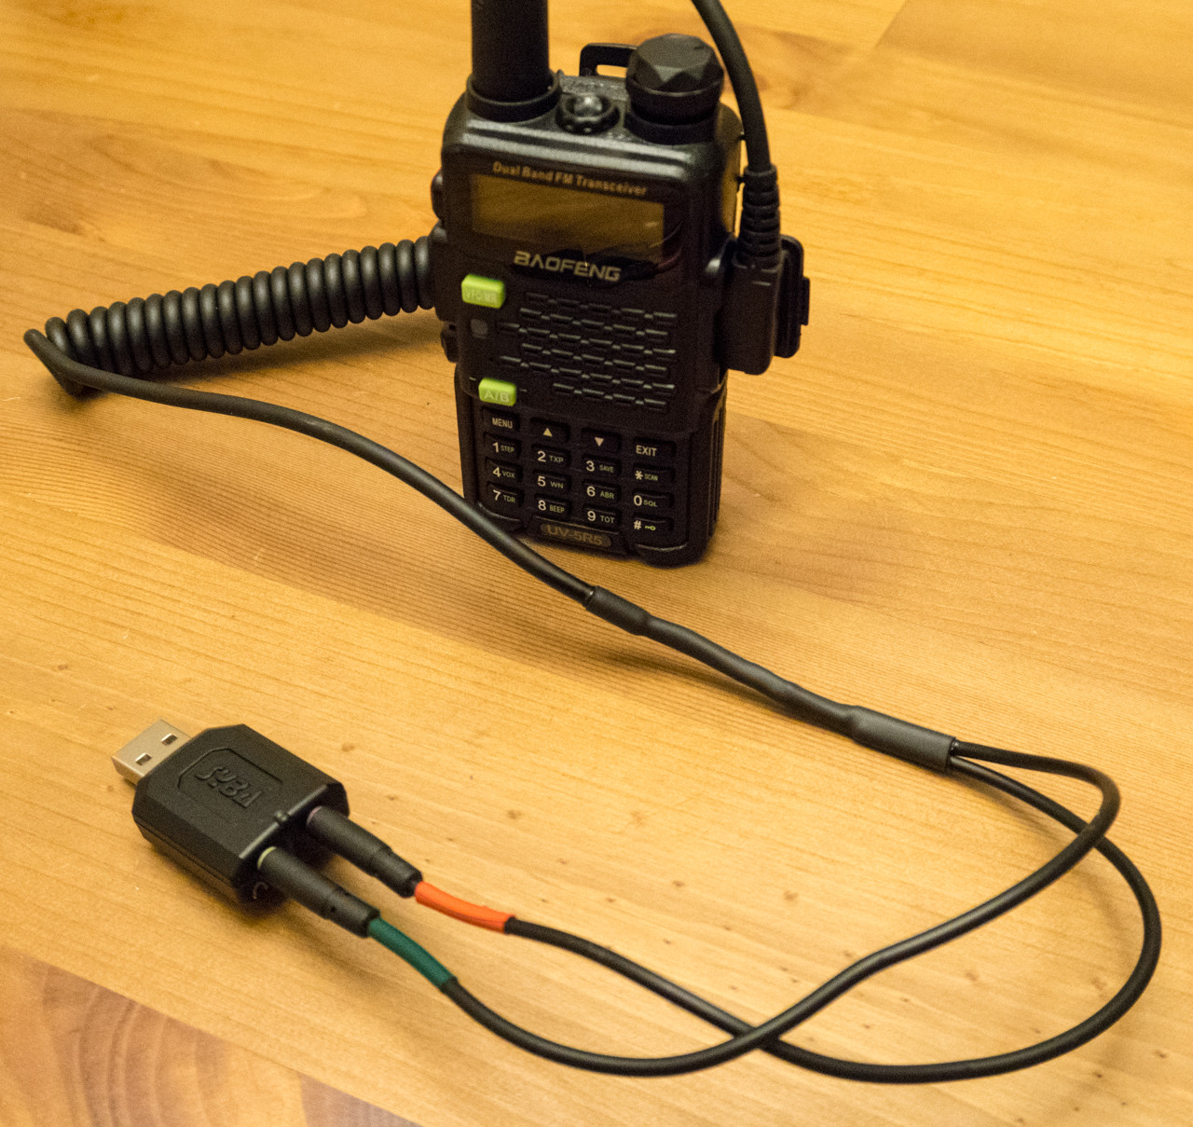
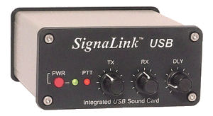
What’s a Soundcard Interface?
SignaLink USB provides a soundcard and PTT Interface to the PC with knobs to control audio levels.
Digirig Mobile
A Budget Modular Interface with
many premade cables with a builtin
soundcard and PTT control
DIY Interface by finding the “Pinout”
of your radio.
Speaker out goes to PC Mic in
Mic in goes to PC speaker out.

Slide 15
Soundcard Interface Cont.
Can be either VOX(Voice Operated Exchanged) or PTT based.
VOX is easier to implement, as only sound in/sound out is needed, but it is highly discouraged for packet use in most cases due to “switch over” delay.
The interface can be homemade for your radio so long as you find a “pinout” of the radios microphone/speaker jack or data jack. You need Line in,Line out, and PTT for a complete interface.

Slide 16
Packet Bulletin board System(BBS)
One of the first wide uses for packet radio by amateurs was the BBS. A BBS is a service offered by dedicated “Nodes” which would provide services to others.
Those services included some of the following:
Messaging, Email, Internet Gateways, Chat, and News. Some BBS systems even provided text based games for amateurs to play.
There are still some BBS systems you can connect to today you can find on: packetradiomap.com
You can also still host your own BBS, as there are several popular free BBS software such as Linfbb, BPQ32, JNOS that run on a variety of operating systems.

Slide 17
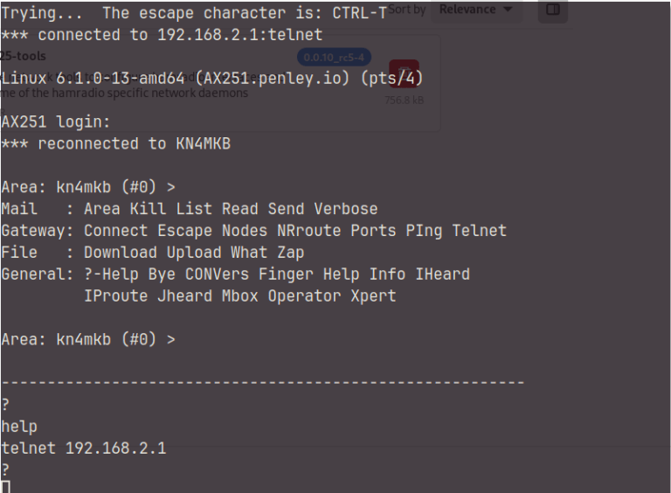
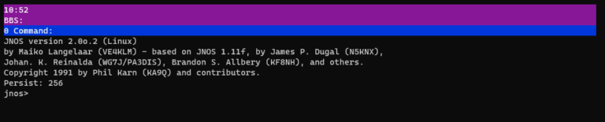
On the left you can see a connection to a
BBS running the JNOS BBS Software
The bottom is an image of the BBS on the
Server itself.

Slide 18
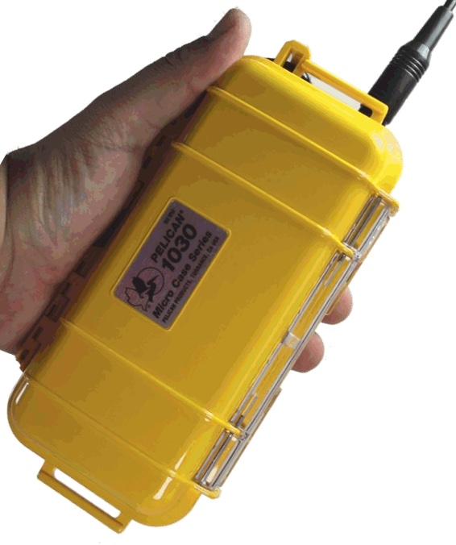
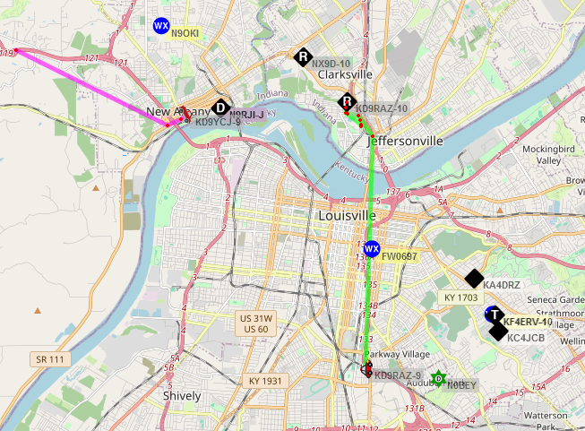
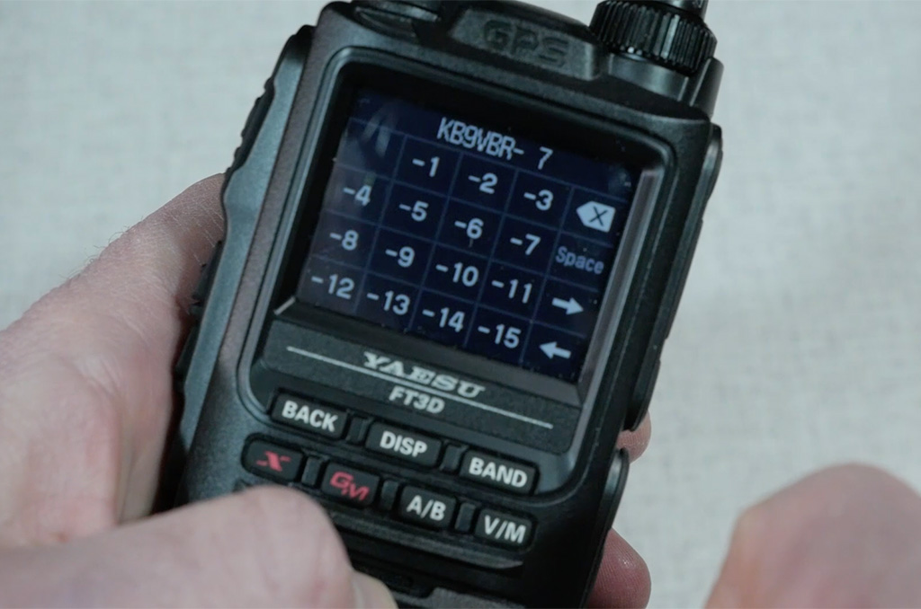
APRS(Automatic Packet Reporting System)
APRS.FI, a website for visually
displaying APRS stations head by
iGates (Internet Gateways)
Commercial APRS
Transmitter by Byonics
K9VB3 Using built in APRS of his
FT3D Radio

Slide 19
What is APRS?
The most popular form of packet radio used today.
Outlines a protocol for sending GPS position data in routine intervals based on
time and speed.
Can send short messages to specific people.
Has a wide existing infrastructure consisting of “Digipeaters” and “iGates”
Digipeaters repeat packets to increase range, and iGates route RF packets to
and from the internet.
Lots of built in support from manufactures.
Lots of EMCOMM use due to the nature of what it does.
Can be used to send/receive messages over SMS,
so long as you can be heard by an iGate.
The ISS(International space Station) contains an APRS digipeater
for public use.

Slide 20
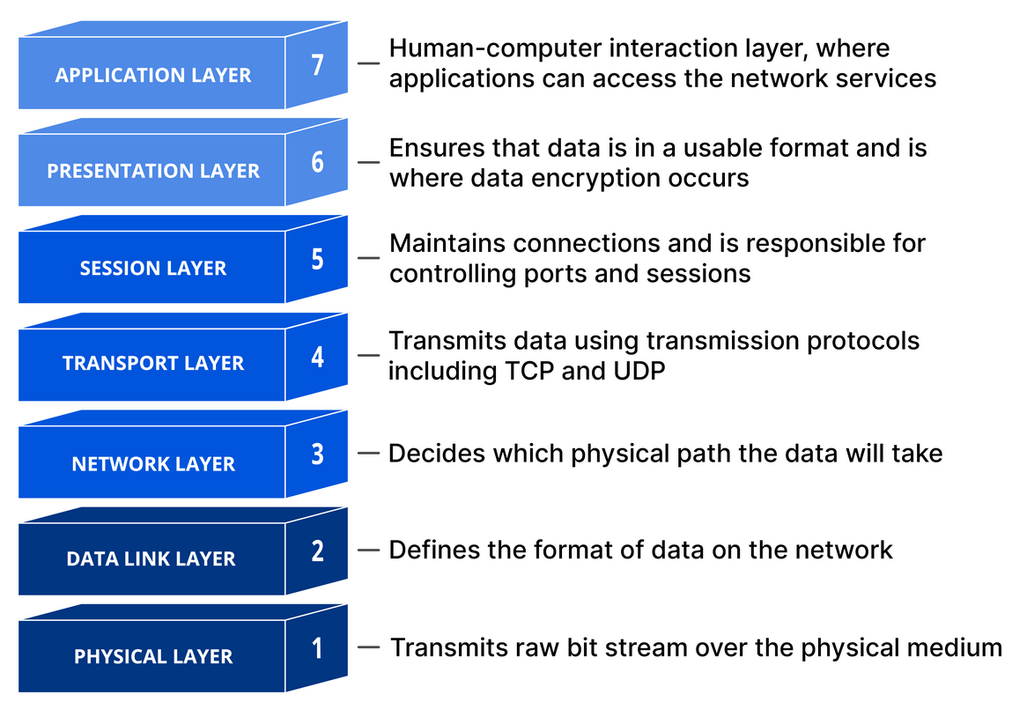
TCP/IP Over Packet Radio Basic Concepts
AX.25 is the “format” in which most
TNC’s structure data. The language
that they “speak”
AX.25 is a data link layer protocol
living on layer 2 of the OSI Model.
Another example of a layer 2
element is Ethernet, which is what
we use most often today for
networking.
This Means your radio, and it’s
antenna live on layer one,where as
we typically use ethernet cable,
and Ethernet ports for Layer 1

Slide 21
TCP/IP Over Packet Radio Basic Concepts Cont.
Linux has historically had built in support for the AX.25 Link layer Protocol, much in the same way it has support for Ethernet.
Much like defining a new Ethernet interface, and an IP Address within Linux, we can also define a new AX25 Interface, and a Callsign for addressing.
More so than this, because IP Addresses live on Layer 3 of the OSI Model, and TCP on Layer 4, we can actually use AX.25 as it’s Layer 2, and the radio as it’s Layer 1, meaning we can have IP 2 IP Communication over Packet Radio.
The tools that facilitate this functionality can be installed on Linux. These include ax25-tools, ax25-apps, kissattach, and tncattach. Combine these with a TNC, and you have your very own packet radio network.

Slide 22
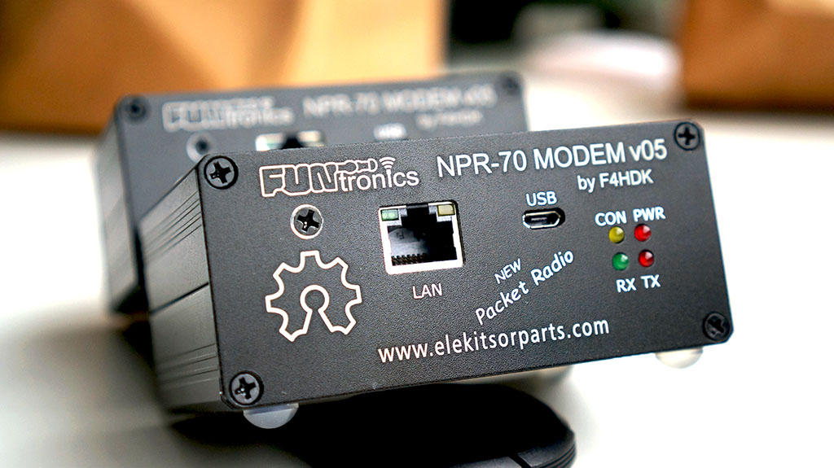
NPR (New Packet Radio)
A NPR modem, made by F4HDK

Slide 23
New Packet Radio
A completely open source modem and protocol for Amateur radio use.
Designed to transport IP traffic over the 70cm ham band with radio Links.
Capable of 50-500kbps, depending on chosen bandwidth.
Connected to a computer with Ethernet, so no additional software or setup is required (plug and play).
Modem build, parts list and firmware all open source.
https://hackaday.io/project/164092-npr-new-packet-radio

Slide 24
Additional Resources
These are resources I’ve found useful for modern information than can be applied
in the real world. I’ve left the 90’s ‘wall of text’ style resources out of this because
lots of the infromation isn’t useful anymore.
https://blog.habets.se/
A personal blog, but has lots of modern documentation on packet radio experiments.
https://www.youtube.com/@KM6LYW https://digipi.org/
Author of “DigiPi” Image, which makes packet radio more accessible to people, using a microcomputer for the software.
https://www.youtube.com/@KM4ACK/
Lots of good content on APRS, and the bleeding edge of APRS Implementation
https://tldp.org/HOWTO/AX25-HOWTO/
Dated 2001, but still a wealth of information about AX25 TCP/IP setup
within Linux.
https://www.zeroretries.org/
Not just Packet Radio, but focuses on the bleeding edge news in the world of digital amateur communication, which includes packet.
https://themodernham.com/
Myself (I document all of my Packet Radio Projects for Modern Operating Systems)

